Slide 1

Mathematical Foundations for Data Science
MFDS Team

Slide 2
DSECL ZC416, MFDS
Lecture No.3

Slide 3

Agenda
Fields
Vector spaces and subspaces
Linear independence and dependence
Bases and dimensions
Linear transformations

Slide 4
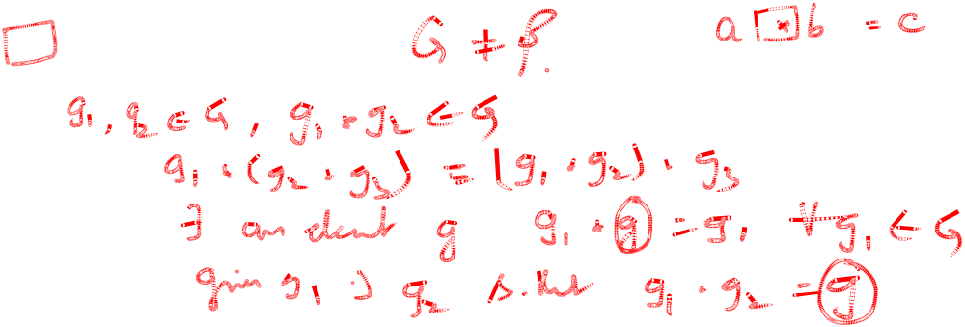


Field – Definition and Examples
Group : (G, ‘*’) is a group if
* is closed
* is associative
* has an identity
* has an inverse
Eg: < R , + > , < R, * >
< G, * > is Abelian if a * b = b * a a,b G
Eg: < R, + > , < R, *> are Abelian
<F,+, .> is a Field if <F, +> and <F, .> are Abelian
Eg: < R, +, .> , < C, +, .>, < Q, +, .>

Slide 5
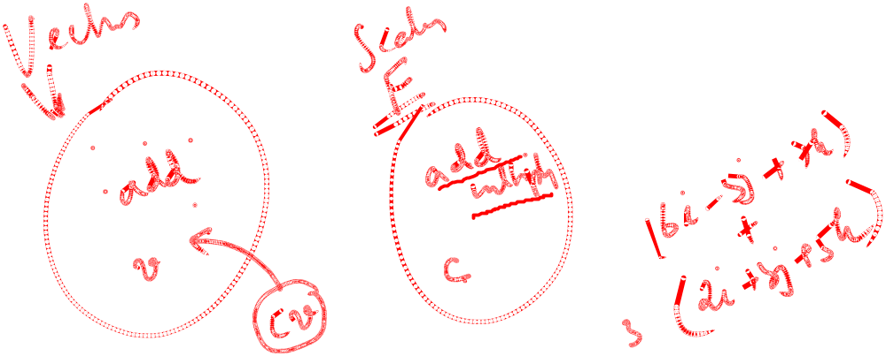
Vector Space
Real Vector Space
A non-empty set V of elements a, b, … is called a real vector space (or real linear space) over a field F, and these elements are called vectors (regardless of their nature, which will come out from the context or will be left arbitrary) if, in V, there are defined two algebraic operations (called vector addition and scalar multiplication) as follows.
I. Vector addition associates with every pair of vectors a and b of V a unique vector of V, called the sum of a and b and denoted by a + b, such that the following axioms are satisfied.

Slide 6

Vector Space
Real Vector Space (continued 1)
I.1 Commutativity. For any two vectors a and b of V,
a + b = b + a.
I.2 Associativity. For any three vectors a, b, c of V,
(a + b) + c = a + (b + c) (written a + b + c).
I.3 There is a unique vector in V, called the zero vector and denoted by 0, such that for every a in V,
a + 0 = a.
I.4 For every a in V, there is a unique vector in V that is denoted by −a and is such that
a + (−a) = 0.

Slide 7
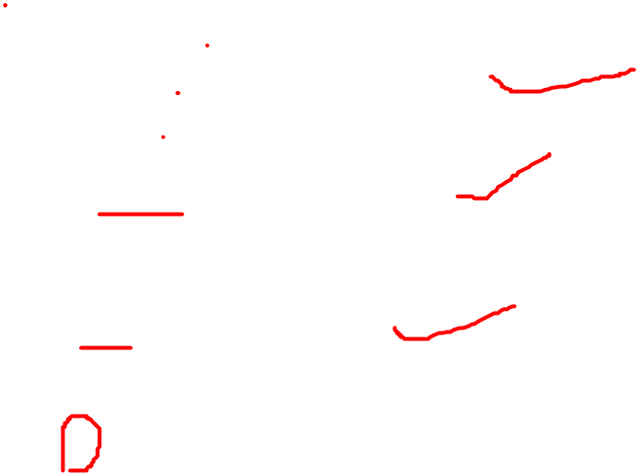
Vector Space
Real Vector Space (continued 2)
II. Scalar multiplication. The real numbers are called scalars. Scalar multiplication associates with every a in V and every scalar c a unique vector of V, called the product of c and a and denoted by ca (or ac) such that the following axioms are satisfied.
II.1 Distributivity. For every scalar c and vectors a and b in V,
c(a + b) = ca + cb.
II.2 Distributivity. For all scalars c and k and every a in V,
(c + k)a = ca + ka.
II.3 Associativity. For all scalars c and k and every a in V,
c(ka) = (ck)a (written cka).
II.4 For every a in V,
1a = a.

Slide 8




Subspace
By a subspace of a vector space V we mean
“a nonempty subset of V (including V itself) that forms a vector space with respect to the two algebraic operations (addition and scalar multiplication) defined for the vectors of V.”
Space within a vector space
W ≠ Φ and W (V, +,.) over F is a subspace if
  0 W, α w₁ +w₂ W
Ex: V = {(x₁, x₂) | x₁ , x₂ R} over R, W = {(x₁ , 0)|x₁ R}
Set of singular matrices is not a subspace of M_{2x2}

Slide 9
Linear Dependence and Independence of Vectors
Given any set of m vectors a₍₁₎, … , a_{(m)} (with the same number of components), a linear combination of these vectors is an expression of the form
c₁a₍₁₎ + c₂ a₍₂₎ + … + c_{m}a_{(m)}
where c₁, c₂, … , c_{m} are any scalars.
Now consider the equation
(1) c₁a₍₁₎ + c₂ a₍₂₎ + … + c_{m}a_{(m)} = 0
Clearly, this vector equation (1) holds if we choose all c_{j}’s zero, because then it becomes 0 = 0.
If this is the only m-tuple of scalars for which (1) holds, then our vectors a₍₁₎ … , a_{(m)} are said to form a linearly independent set or, more briefly, we call them linearly independent.

Slide 10
Linear Dependence and Independence of Vectors
Otherwise, if (1) also holds with scalars not all zero, we call these vectors linearly dependent.
This means that we can express at least one of the vectors as a linear combination of the other vectors. For instance, if (1) holds with, say, c₁ ≠ 0, we can solve (1) for a₍₁₎:
a₍₁₎ = k₂ a₍₂₎ + … + k_{m}a_{(m)} where k_{j} = −c_{j} /c₁.
The rank of a matrix A is the maximum number of linearly independent row vectors of A.
It is denoted by rank A.

Slide 11


Basis and Dimension
The maximum number of linearly independent vectors in V is called the dimension of V and is denoted by dim V.
A linearly independent set in V consisting of a maximum possible number of vectors in V is called a basis for V.
The number of vectors of a basis for V equals dim V.
The vector space R^{n} over R consisting of all vectors with n components (n real numbers) has dimension n.
R over R → One dimensional vector space
C over C → One dimensional vector space
C over R → Two dimensional vector space
If W = {0}, then W is generated by Φ and hence dim(W) = 0

Slide 12
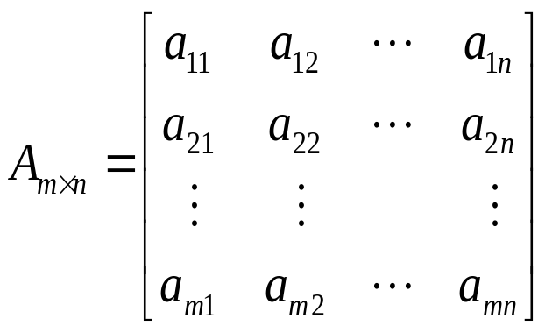
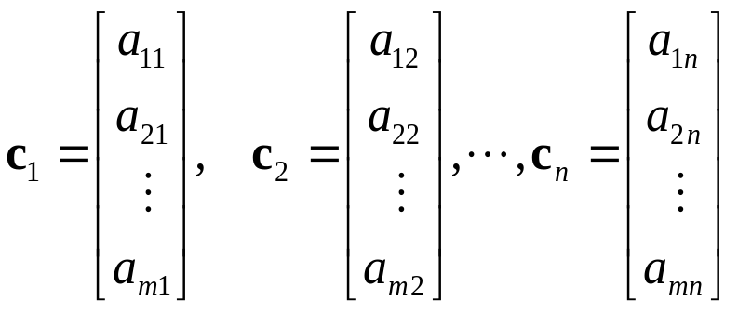
Row Space and Column Space
  If A is an m×n matrix
    the subspace of R^{n} spanned by the row vectors of A is called the row space of A
    the subspace of R^{m} spanned by the column vectors is called the column space of A
  The solution space of the homogeneous system of equation Ax = 0, which is a subspace of R^{n}, is called the nullspace of A.

Slide 13
Basis for Row Space and Column Space
If a matrix R is in row echelon form
  the row vectors with the leading 1’s (i.e., the nonzero row vectors) form a basis for the row space of R
  the column vectors with the leading 1’s of the row vectors form a basis for the column space of R

Slide 14
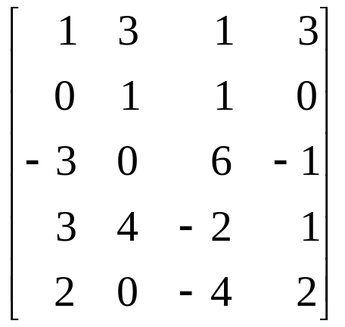
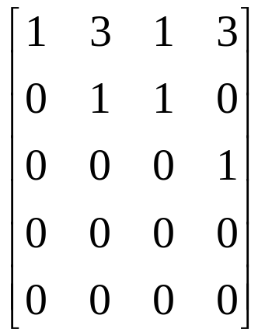

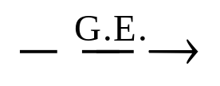
Basis for Row Space
Find a basis of row space of A =
Sol:
A=
B =
a basis for RS(A) = {the nonzero row vectors of B}
= {w₁, w₂, w₃} = {(1, 3, 1, 3) , (0, 1, 1, 0) ,(0, 0, 0, 1)}

Slide 15
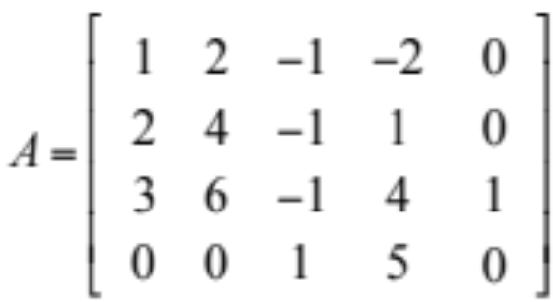
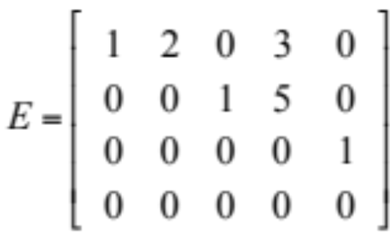
Basis for Column Space
Find a basis for the column space
of the matrix A.
a₁ a₂ a₃ a₄ a₅
Reduce A to the reduced row- echelon form
= [e₁ e₂ e₃ e₄ e₅ ]
e₂ = 2e₁ ➔ a₂ = 2a₁
e₄ = 3e₁ + 5e₃ ➔ a₄ = 3a₁ + 5a₃
{a₁ , a₃ , a₅ } is a basis for column space of A

Slide 16
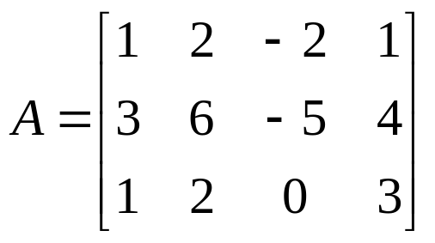
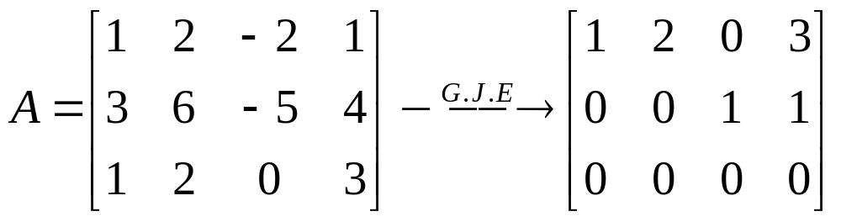
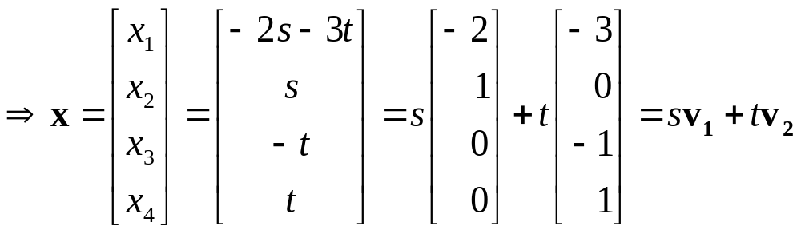

Solution Space/ Null Space
Find the solution space of a homogeneous system Ax = 0.
x₁ = –2s – 3t, x₂ = s,
x₃ = –t, x₄ = t
Nullity(A) = dim(NS(A)) = 2

Slide 17
RS, CS, Rank(A)
Theorem : (Row and column space have equal dimensions)
If A is an m×n matrix, then the row space and the column
space of A have the same dimension.
dim(RS(A)) = dim(CS(A))
Rank:
The dimension of the row (or column) space of a matrix A is called the rank of A.
rank(A) = dim(RS(A)) = dim(CS(A))

Slide 18
Nullity of Matrix
Nullity: The dimension of the nullspace of A is called the nullity of A nullity(A) = dim(NS(A))
Notes:
rank(A^{T}) = dim(RS(A^{T})) = dim(CS(A)) = rank(A)
Therefore rank(A^{T} ) = rank(A)
Theorem : (Dimension of the solution space)
If A is an m×n matrix of rank r, then the dimension of the solution space of Ax = 0 is n – r. That is
nullity(A) =n - rank(A)= n-r
n=rank(A)+nullity(A)
Rank Nullity Theorem for Matrix

Slide 19
Rank and Nullity of Matrix
If A is an m×n matrix and rank(A) = r, then
Fundamental Space | Dimension
RS(A)=CS(A^{T}) | r
CS(A)=RS(A^{T}) | r
NS(A) | n – r
NS(A^{T}) | m – r

Slide 20
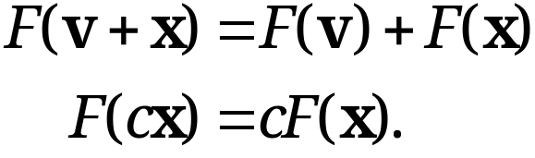

Linear Transformation
Let X and Y be any vector spaces. To each vector x in X we assign a unique vector y in Y. Then we say that a mapping (or transformation or operator) of X into Y is given.
Such a mapping is denoted by a capital letter, say F. The vector y in Y assigned to a vector x in X is called the image of x under F and is denoted by F(x) [or Fx, without parentheses].
F is called a linear mapping or linear transformation if, for all vectors v and x in X and scalars c,
(10)

Slide 21
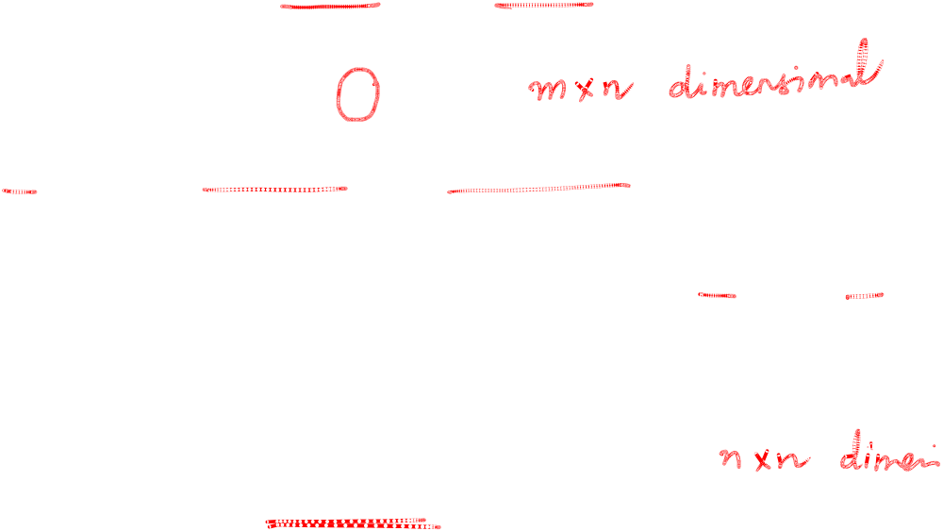
Linear Transformation of Space R^{n} into Space R^{m}
From now on we let X = R^{n} and Y = R^{m}. Then any real m × n matrix A = [a_{jk}] gives a transformation of R^{n} into R^{m},
(11) y = Ax.
Since A(u + x) = Au + Ax and A(cx) = cAx, this transformation is linear.
If A in (11) is square, n × n, then (11) maps R^{n} into R^{n}. If this A is non-singular, so that A⁻¹ exists (see Sec. 7.8), then multiplication of (11) by A⁻¹ from the left and use of
A⁻¹A = I gives the inverse transformation
(14) x = A⁻¹ y.
It maps every y = y₀ onto that x, which by (11) is mapped onto y₀. The inverse of a linear transformation is itself linear, because it is given by a matrix, as (14) shows.

Slide 22
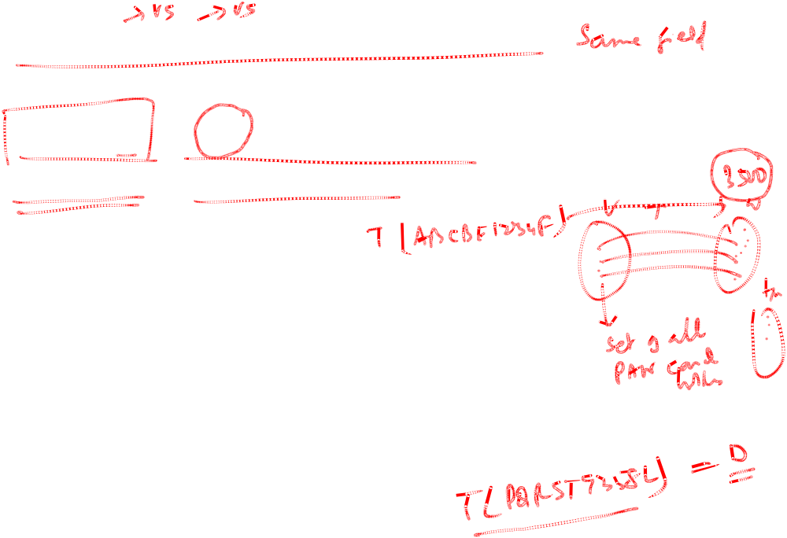
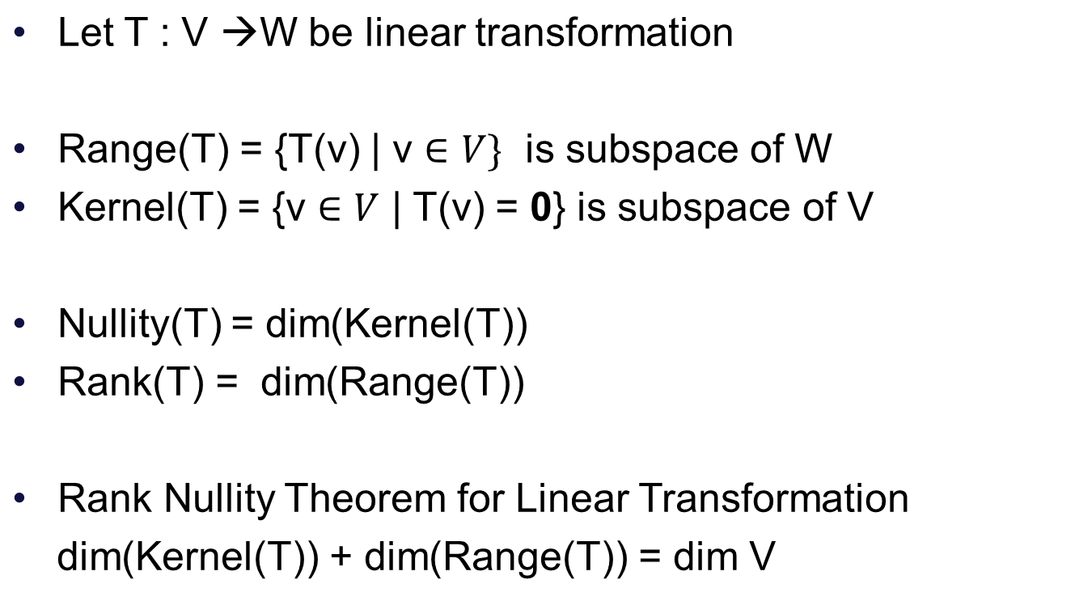
Range and Kernel

Slide 23

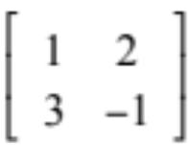
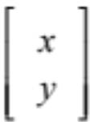
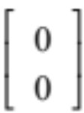
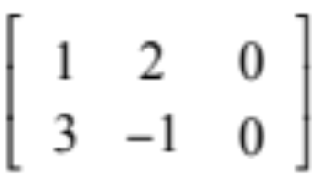
Rank Nullity Theorem Example
T : R² →R² , T(x) = Ax where A = Find the rank and
nullity of linear transformation and verify the Rank Nullity
Theorem
Let v = [x , y] be a vector of R², v ker(T)
Av = 0
=
Augmented Matrix
x = 0 , y = 0 ➔ ker T = [0, 0]
Range Space of T is R(T) = col (A)

Slide 24
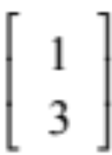
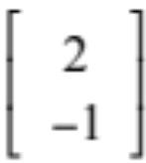
Rank Nullity Theorem Example
Range Space of T is R(T) = col (A)
= { x₁ + x₂ x₁ , x₂ R }
Nullity T = 0
Basis for R(T) = { , }
Rank T = dim [R(T)] = 2
Rank T + nullity T = 2 + 0 = 2 = dim V
dim V = dim R² = 2
Hence Rank Nullity Theorem is verified

